Slide 1


CWCT 140
Professor David Lieberman
dlieberman@ivytech.edu

Slide 2
Agenda
Procedural Programming
Classes and Objects
Instantiation
Inheritance
Encapsulation
Polymorphism
Overloaded Constructor
Animal Class Example
Programming Exercise

Slide 3
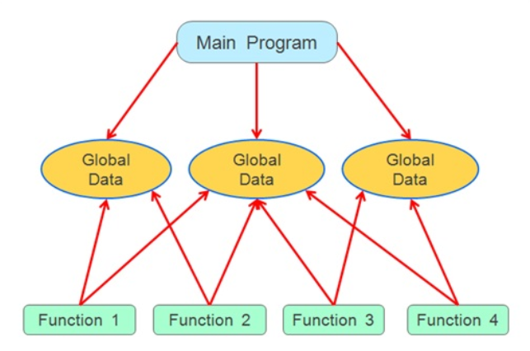
Procedural Programming

Slide 4
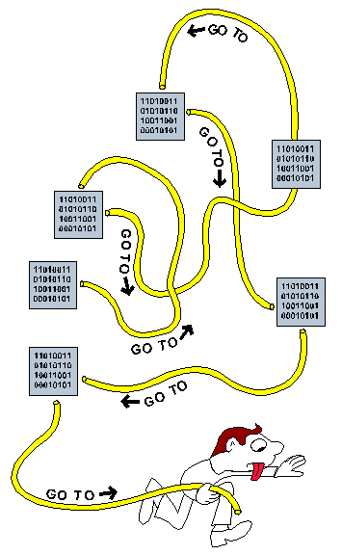
Procedural Programming
“Spaghetti” Code

Slide 5
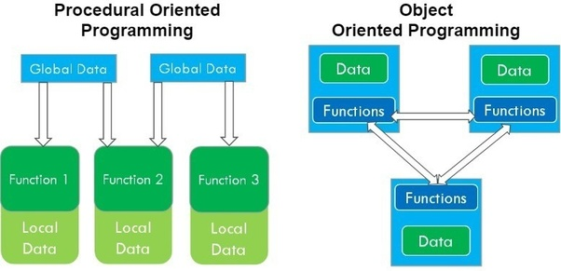
Procedural Vs Object-Oriented
In OOP, each “object” is self-contained

Slide 6
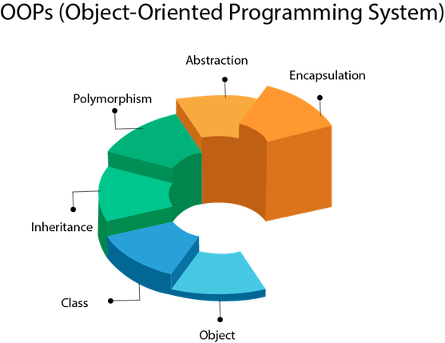
Object Oriented Programming

Slide 7
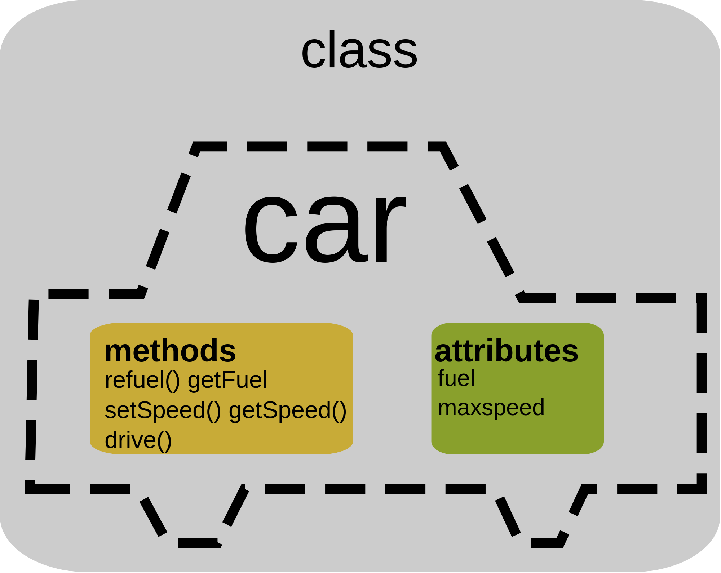
Classes
A class is a template (or blueprint) from which objects are created. For example, a “Dodge” object could be created from a “Car” class

Slide 8
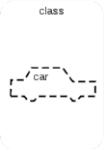
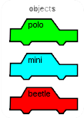

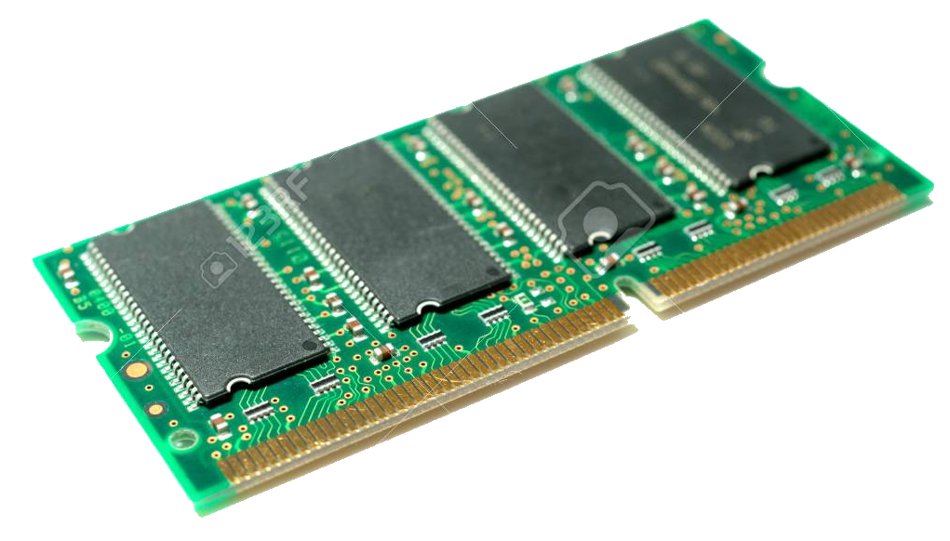

Objects - Instantiation
Objects must be “instantiated”. This is a fancy word meaning – “allocating memory for the object”.

Slide 9
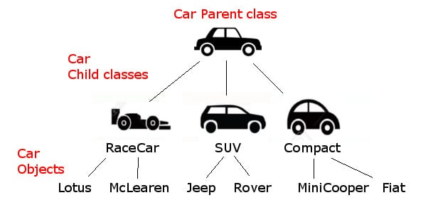
Inheritance
Inheritance is the ability to extend the blueprint (class). As an example, a RaceCar class may be derived from the Car class

Slide 10
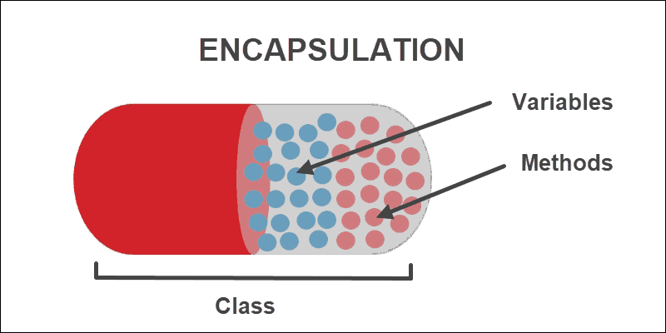
Encapsulation
Encapsulation refers to the techniques of packaging these attributes and properties into one stand-alone unit. These units can be looked at as a black box

Slide 11
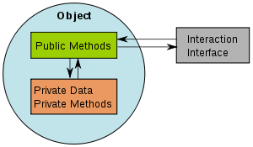
Encapsulation
To be able to use (or reuse) this black box in a program, all we really need to know is how to interface with it; we do not necessarily need to know what it contains within

Slide 12
Polymorphism
Polymorphism (which may be one of the more complex features of OOP) is the ability to create methods that act differently depending on the context
"one interface, multiple methods"

Slide 13
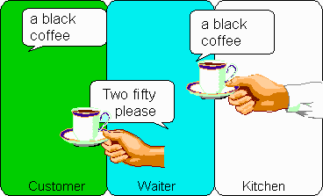
Polymorphism
Both waiter as kitchen respond to a ‘black coffee'. The actions are different though.

Slide 14
Polymorphism
The waiter passes the message to the kitchen, waits for response, delivers coffee and settles the account.

Slide 15
Polymorphism
The kitchen brews fresh coffee and passes it to the waiter.

Slide 16
Polymorphism
The same message with different implementations, that is polymorphism.

Slide 17
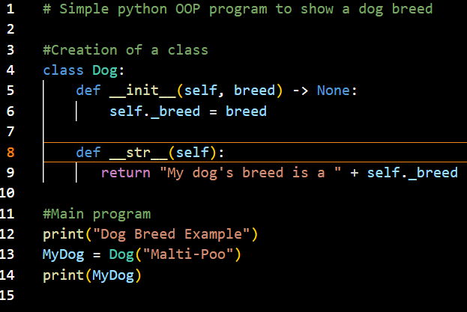

Overloaded Constructor / Method
Overloaded Constructor
Method Overridden
Instantiation

Slide 18

Animal Class
Design an Animal class that resolves the following console program:
# Main program
myDog = Animal("dog", "bark")
myCat = Animal("cat", "meow")
print(myDog)
print(myCat)
myDog.setSound("woof woof")
print(myDog)

Slide 19
Animal Class
Pseudo-code
# Animal Class
# - declare the “Animal” class
# - create constructor that takes description and sound as parameters
# - store description and sound as attributes
# - create a “setSound” methods that modifies the sound attribute
# - create a “setDescription” methods that modifies the description
# - override the __str__ method to return the following string:
# - "I am a " + self._description + " and I " + self._sound

Slide 20
Programming Assignment
Download “radio_exercise.py” which contains two sections of code:
Pseudo-code for a Radio class
Unit test program that utilizes the Radio class
Download the “radio.png” image. Make sure the radioimage variable points to the location of the file
Create a Radio class that resolves execution of the unit test program

Slide 21
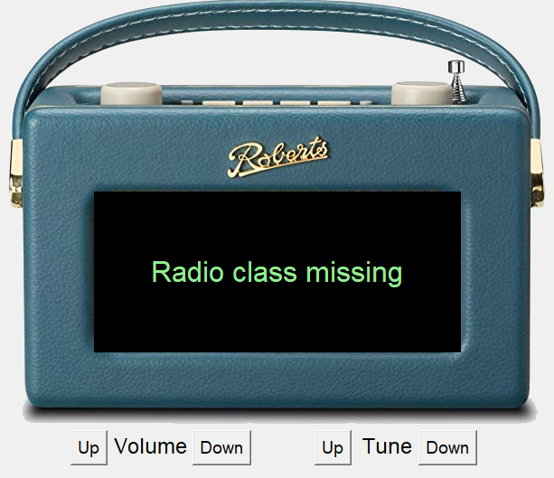
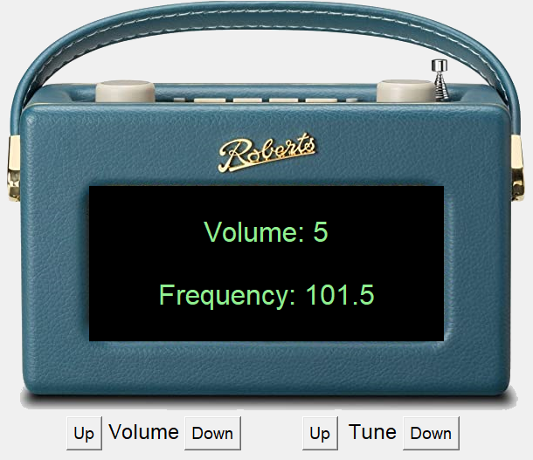
Assignment
#Define "Radio" class here
# - constructor takes initial volume and frequency
# - VolumeUp method increases volume by 1 to limit of 10
# - VolumeDown method decreases volume by 1 to limit of 0
# - FrequencyUp method increases frequency by 0.1 to limit of 108.0
# - FrequencyDown method decreases frequency by 0.1 to limit of 88.0
# - __str__ method returns volume and frequency as illustrated below:
# - return "Volume: " + str(self._volume) + "\n\nFrequency: " + str(round(self._frequency, 1))

